Slide 1
Bus Reservation and Tracking System
By: Mohamed Hussein Abo El-Ela | 224175
Supervisor: Dr. Ali Hamdi

Slide 2
Table of contents
01
02
03
04
07
Introduction
Problem Statement
08
Challenges
Motivation
Related Work
Review of Best 5 papers
05
Quality of the papers (publication)
06
Limitation

Slide 3
01
Introduction

Slide 4
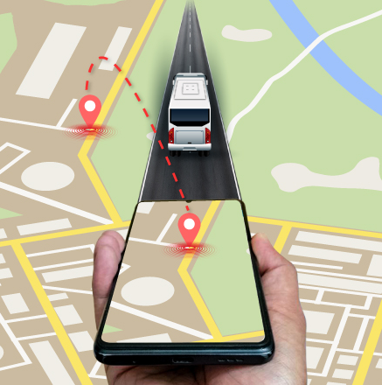
Introduction
The project involves developing a Bus Reservation and Tracking System using Geographic Information System (GIS) and Spatial Temporal data to simulate a realistic urban transportation system in Berlin. The simulation is executed using Python and SUMO (Simulation of Urban Mobility)

Slide 5
02
Motivation

Slide 6
Motivation
Why Should It be Done?
Urban Mobility: Increasing urbanization leads to traffic congestion and inefficient public transport systems. This project aims to alleviate these issues by optimizing bus routes and tracking vehicles in real-time.
Evidence: The simulation offers real-time data to improve bus management, leading to more efficient public transportation

Slide 7
03
Related Work

Slide 8
Related Work
What people did
Various researchers have developed systems for bus tracking and scheduling using different models like Kalman filters and machine learning, focusing on improving bus arrival time prediction and reducing delays in urban areas

Slide 9
04
Review of Best papers

Slide 10
"Urban Bus Arrival Time Prediction: A Review of Computational Models"
Problem: Accurately predicting bus arrival times in dynamic urban settings.
Contribution: Reviews methods like Kalman filtering, historical data analysis, and artificial neural networks (ANN).
Results: Kalman filters and ANN models provide more accurate predictions compared to statistical methods

Slide 11
"Development of an Algorithm for Bus Routing and Tracking for an Educational Institution"
Problem: Inefficient bus routing and allocation of bus stops.
Contribution: Developed an algorithm for optimized bus routing and real-time tracking.
Results: Improved efficiency and reduced wait times for students

Slide 12
"A Simulation-Based Optimization Approach for Designing Transit Networks"
Problem: Balancing efficient transit networks while minimizing costs.
Contribution: Introduced a model that integrates simulation and optimization for transit networks.
Results: Improved transit network efficiency in Cape Town.

Slide 13
"CrowdWeb: A Visualization Tool for Mobility Patterns in Smart Cities"
Problem: Detecting human mobility patterns for urban planning.
Contribution: Developed a platform for real-time visualization of mobility data.
Results: Provides insights into crowd movement, useful for traffic management​

Slide 14
"Modeling of a Mode Choice Behavior Toward Mobility as a Service (MaaS)"
Problem: Integrating on-demand shared services into public transport.
Contribution: Proposed a simulation framework for evaluating on-demand service impact.
Results: Demonstrated cost-benefit for on-demand service integration​

Slide 15
05
Quality of the papers

Slide 16
Quality of the Papers
Publication Venues:
All papers are published in reputable journals such as Applied Sciences and IEEE, ensuring high credibility.

Slide 17
06
Limitation

Slide 18
Limitation
Real-world implementation of these systems is constrained by unpredictable traffic conditions, varying data quality, and computational complexity in large-scale simulations​

Slide 19
07
Problem Statement

Slide 20
Problem Statement
How can we develop a bus tracking system that efficiently manages dynamic traffic conditions and unpredictable passenger demand in real-time?

Slide 21
08
Challenges

Slide 22
Challenges
Key Challenges:
Handling real-time data from multiple buses.
Simulating realistic traffic conditions in urban settings.
Ensuring the scalability and accuracy of predictions across different urban regions​

Slide 23
Thank you
Any Questions?
Contact me:
Phone: +20 122 157 5493
Email: mohamed.hussein20.msa.edu.eg
Portfolio: portfolio-mohamedhussein.vercel.app

